Slide 1
Chapter 15 Monopolistic Competition and Product Differentiation
THIRD EDITION
MICROECONOMICS Paul Krugman | Robin Wells
>>
Notes:
0

Slide 2
The meaning of monopolistic competition
Why oligopolists and monopolistically competitive firms differentiate their products
How prices and profits are determined in monopolistic competition in the short run and the long run
Why monopolistic competition poses a trade-off between lower prices and greater product diversity
The economic significance of advertising and brand names
WHAT YOU
WILL LEARN
IN THIS CHAPTER
Notes:
1

Slide 3
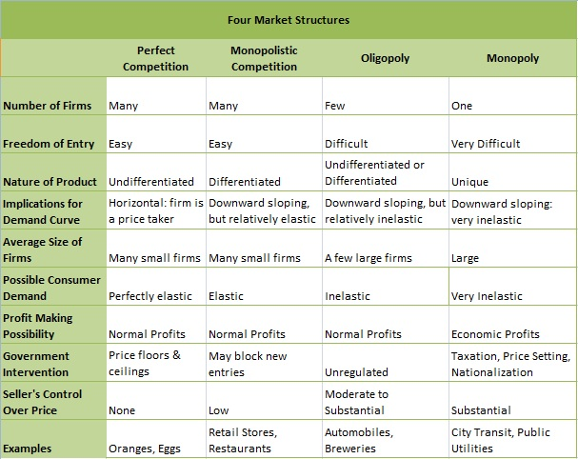
Four Market Structures
More competition Less competition
Notes:
2

Slide 4
The Meaning of Monopolistic Competition
Monopolistic competition
Perfect competition
(Perfectly elastic firm demand)
More Product Differentiation
(lower elasticity of demand)
More competition Less competition
(less price control) (more price control)
Monopolistic competition is a market structure in which
There are many competing producers in an industry
Each producer sells a differentiated product
firms face a downward sloping demand curve
firms are not price takers
The industry has free entry and exit in the long run
firms make zero economic profit in the long run
Notes:
3

Slide 5
Product Differentiation
Product differentiation is important to oligopolies.
It reduces competition and allows higher profits.
Product differentiation plays an even more crucial role in monopolistically competitive industries.
Why?
Collusion or tacit cooperation is virtually impossible when there are many producers.
Hence, product differentiation is the only way monopolistically competitive firms can acquire some market power and avoid zero profits.
Notes:
4

Slide 6
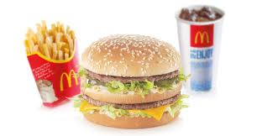
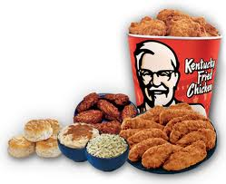




Product Differentiation
How do firms in the same industry—such as fast-food vendors, gas stations, or chocolate companies—differentiate their products?
Is the difference mainly in the minds of consumers or in the products themselves?
Notes:
5

Slide 7
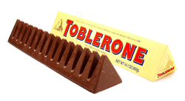
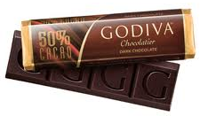
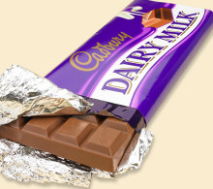
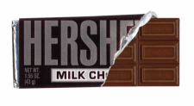
Product Differentiation
There are three important forms of product differentiation:
Differentiation by style or type – sedans vs. SUVs
2) Differentiation by location – dry cleaner near home vs. cheaper dry cleaner far away
3) Differentiation by quality – ordinary chocolate ($) vs. gourmet chocolate ($$$)
Notes:
6

Slide 8
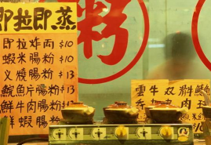
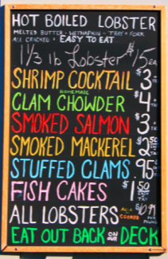

Product Differentiation
Whatever form it takes, however, there are two important features of industries with differentiated products:
Competition among sellers: Producers compete for the same market, so entry by more producers reduces the quantity each existing producer sells at any given price.
Value in diversity: In addition, consumers gain from the increased diversity of products.
Restaurants: monopolistic competitors
Notes:
7

Slide 9
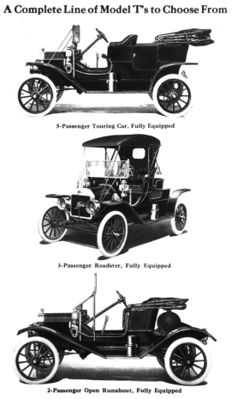
Case Study: Any Color, So Long As It’s Black
In 1913, Henry Ford built the first moving assembly line for the mass production of cars, dramatically lowering the cost of production
Cars became much more affordable
Ford cars took over the market
Ford’s strategy was to offer just one style of car, which maximized his economies of scale but made no concessions to differences in taste.
Alfred P. Sloan of General Motors (GM) challenged this strategy by offering a range of car types, differentiated by quality and price.
By the 1930s the verdict was clear: Customers preferred a range of styles!
Notes:
1930 Ford model A (black), Pontiac (red)
8

Slide 10
Understanding Monopolistic Competition
As the term monopolistic competition suggests, this market structure combines some features typical of monopoly with others typical of perfect competition:
Because each firm is offering a distinct product, it is in a way like a monopolist: it faces a downward-sloping demand curve and has some market power—the ability within limits to determine the price of its product.
However, unlike a pure monopolist, a monopolistically competitive firm does face competition: the amount of product it can sell depends on the prices and products offered by other firms in the industry.
Notes:
9

Slide 11
Monopolistic Competition in the Short Run
The following figure shows two possible situations that a typical firm in a monopolistically competitive industry might face in the short run.
The firm may make a Profit or a Loss
In each case, the firm looks like any monopolist: it faces a downward-sloping demand curve, which implies a downward-sloping marginal revenue curve.
Choose profit maximizing quantity where MC = MR
We assume that every firm has an upward-sloping marginal cost curve, but that it also faces some fixed costs, so that its average total cost curve is U-shaped.
Notes:
10

Slide 12

Monopolistic Competition in the Short Run
Price, cost, marginal revenue
(a) A Profitable Firm
Price, cost, marginal revenue
(b) An Unprofitable Firm
MC
MC
ATC
ATC
P
P
Profit
ATC
U
ATC
P
Loss
P
U
D
P
D
U
MR
P
MR
U
Q
P
Quantity
Q
U
Quantity
Profit-maximizing quantity
Loss-minimizing quantity
Notes:
Figure Caption: Figure 15-1: The Monopolistically Competitive Firm in the Short Run
The firm in panel (a) can be profitable for some output quantities: the quantities for which its average total cost curve, ATC, lies below its demand curve, DP. The profit-maximizing output quantity is QP, the output at which marginal revenue, MRP, is equal to marginal cost, MC. The firm charges price PP and earns a profit, represented by the area of the green shaded rectangle. The firm in panel (b), however, can never be profitable because its average total cost curve lies above its demand curve, DU, for every output quantity. The best that it can do if it produces at all is to produce quantity QU and charge price PU. This generates a loss, indicated by the area of the yellow shaded rectangle. Any other output quantity results in a greater loss.
11

Slide 13
Monopolistic Competition Short Run Equilibrium
All firms practice profit maximization
Produce the quantity where marginal revenue = marginal cost
Monopolistically competitive firm is like a monopolist
Demand is downward sloping: MR << P
Find Q where MR = MC
Price: on the demand curve
Just like under perfect competition, a monopolistically competitive firm can experience either a profit or a loss
If P > ATC : Profit
If P < ATC : Loss

Slide 14
Monopolistic Competition in the Long Run
If the typical firm earns positive profits, new firms will enter the industry in the long run, shifting each existing firm’s demand curve to the left.
If the typical firm incurs losses, some existing firms will exit the industry in the long run, shifting the demand curve of each remaining firm to the right.
In the long run, equilibrium of a monopolistically competitive industry, the zero-profit-equilibrium, firms just break even.
The typical firm’s demand curve is just tangent to its average total cost curve at its profit-maximizing output.
Notes:
13

Slide 15
Entry and Exit Shift Demand and Marginal Revenue
Price, marginal revenue
Price, marginal revenue
(a) Effects of Entry
(b) Effects of Exit
Entry shifts the existing firm’s demand curve and its marginal revenue curve leftward.
Exit shifts the existing firm’s demand curve and its marginal revenue curve rightward.
D
2
MR
MR
D
D
1
MR
MR
D
2
1
2
1
2
1
Quantity
Quantity
Notes:
Figure Caption: Figure 15-2: Entry and Exit Shift Existing Firm’s Demand Curve and Marginal Revenue Curve
Entry will occur in the long run when existing firms are profitable. In panel (a), entry causes each existing firm’s demand curve and marginal revenue curve to shift to the left. The firm receives a lower price for every unit it sells, and its profit falls. Entry will cease when firms make zero profit. Exit will occur in the long run when existing firms are unprofitable. In panel (b), exit from the industry shifts each remaining firm’s demand curve and marginal revenue curve to the right. The firm receives a higher price for every unit it sells, and loss declines. Exit will cease when the remaining firms make zero profit.

Slide 16
Entry Reduces Profits of Existing Firms
Price, cost, marginal revenue
MC
P
1
ATC
Profit₁
P
2
Profit₂
MC = MR
MC = MR
D₁
MC
MR₂
MR₁
D₂
Q
2
Q
1
Quantity
Notes:
If existing firms are profitable, entry will occur and shift each existing firm’s demand curve leftward. Firm entry will reduce demand for the existing firms, punishing down their prices and profits.

Slide 17
The Long-Run Zero-Profit Equilibrium
Price, cost, marginal revenue
MC
Point of tangency
A
T
C
Z
P
=
A
T
C
LR
LR
MR
D
LR
LR
Q
LR
Quantity
Notes:
Figure Caption: Figure 15-3: The Long-Run Zero-Profit Equilibrium
If existing firms are profitable, entry will occur and shift each existing firm’s demand curve leftward. If existing firms are unprofitable, each remaining firm’s demand curve shifts rightward as some firms exit the industry. Entry and exit will cease when every existing firm makes zero profit at its profit-maximizing quantity. So, in long-run zero-profit equilibrium, the demand curve of each firm is tangent to its average total cost curve at its profit-maximizing quantity: at the profit maximizing quantity, QMC, price, PMC, equals average total cost, ATCMC. A monopolistically competitive firm is like a monopolist without monopoly profits.

Slide 18
Monopolistic Competition versus Perfect Competition
Most industries are monopolistically competitive.
It is the most common market structure.
Price exceeds marginal cost, so some mutually beneficial trades are unexploited.
Firms charge a mark-up over their marginal cost.
In the long-run equilibrium of a monopolistically competitive industry, there are many firms, all earning zero profit.
Firms operate at a level of production less than their minimum ATC.
There is excess capacity.
A monopolistically competitive firm produces less than a similar firm in a perfectly competitive market.
Notes:
17

Slide 19
Comparing LR Equilibrium with Perfect Competition
Price, cost, marginal revenue
(a) Long-Run Equilibrium in Perfect Competition
Price, cost, marginal revenue
(b) Long-Run Equilibrium in Monopolistic Competition
Excess Capacity
MC
A
T
C
MC
A
T
C
P
MC
=
A
T
C
MC
P
PC
= MC
D
=
MR
=
P
PC
PC
Mark-up
=
A
T
C
PC
MC
MC
MR
D
MC
MC
Q
PC
Quantity
Q
MC
Quantity
Minimum-cost output
Minimum-cost output
Notes:
Figure Caption: Figure 15-4: Comparing Long-Run Equilibrium in Perfect Competition and Monopolistic Competition
Panel (a) shows the situation of the typical firm in long-run equilibrium in a perfectly competitive industry. The firm operates at the minimum-cost output QPC, sells at the competitive market price PPC, and makes zero profit. It is indifferent to selling another unit of output because PPC is equal to its marginal cost, MCPC. Panel (b) shows the situation of the typical firm in long-run equilibrium in a monopolistically competitive industry. At QMC it makes zero profit because its price PMC just equals average total cost, ATCMC. At QMC the firm would like to sell another unit at price PMC since PMC exceeds marginal cost, MCMC. But it is unwilling to lower price to make more sales. It therefore operates to the left of the minimum-cost output level and has excess capacity.
18

Slide 20
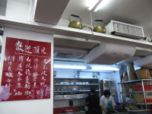
Is Monopolistic Competition Inefficient?
When compared with perfect competition, prices are higher under monopolistic competition.
Firms produce less than the output at which average total cost is minimized.
Firms charge a price that is higher than the marginal cost of production.
The higher price consumers pay because of excess capacity is offset to some extent by the value they receive from greater diversity.
It is not clear that there is any inefficiency because of excess capacity.
Would you prefer to live where there is only one (low priced) restaurant, or where there are a few restaurants (but with higher prices)?
Notes:
19

Slide 21
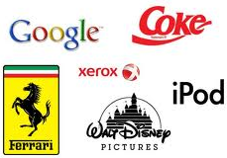

Controversies About Product Differentiation
No discussion of product differentiation is complete discussing the two related issues of advertising and brand names.
Does it make a product better if a celebrity uses it?
Why does it matter whether or not your favorite celebrity wears a brand of watch?
Notes:
20

Slide 22
The Role of Advertising
Advertising spending
Highly differentiated consumer goods: 10-20% of revenue
Industrial products: Little advertising
Homogenous products: No advertising
Incentive to advertise
Firms in perfectly competitive markets do not advertise
Can always sell production at market price
Firms advertise when they sell differentiated products and charge prices above marginal cost
To attract more buyers
To reduce price elasticity of demand
Allows a higher price mark-up

Slide 23
The Role of Advertising
Debate over advertising
Is it a waste of valuable resources?
Does it convey information to the consumer?
Critique of advertising
Firms advertise to manipulate people’s tastes
Psychological rather than informational
Creates a desire that otherwise might not exist
Increase perception of product differentiation
Fosters brand loyalty
Impedes competition
Makes buyers less concerned with price differences among similar goods

Slide 24
Advertising
Defense of advertising
Advertising is not a waste of resources when it gives consumers useful information about products.
Customers can make better choices and choose the best product for their needs
Enhances the ability of markets to allocate resources efficiently
Advertising allows a firm to demonstrate their participation and commitment to a market.
Advertising can foster competition
Customers are more aware of substitutes and alternatives
Can take advantage of price differences
Allows new firms to enter more easily

Slide 25
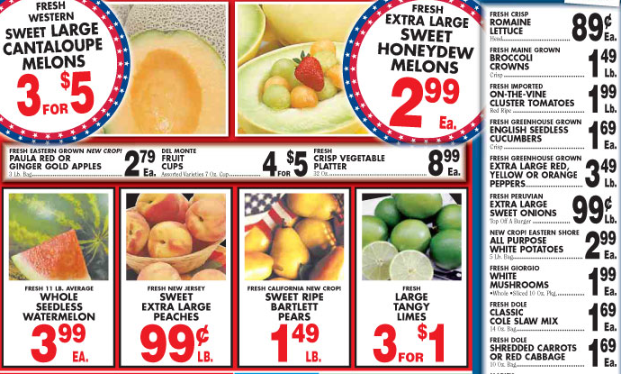
Informative Advertising
Advertising to convey information
Price, quality and availability information

Slide 26
Advertising and the price of eyeglasses
In 1963, various states in the US started allowing advertising by optometrists:
States that prohibited advertising
Average price paid for a pair of eyeglasses = $33
States that did not restrict advertising
Average price = $26
The study found that advertising informed consumers of alternatives
Consumers – easier to find firms with better prices
Reduced average prices
Fostered competition
Firms’ demand became more elastic

Slide 27



Brand Names: A Signal of Quality?
Advertising that creates and promotes a brand
Has little apparent information
Is frequently considered wasteful
The information offered – a signal about quality
Willingness to spend money on brand
Signals the quality of the product
Content of advertising is irrelevant

Slide 28
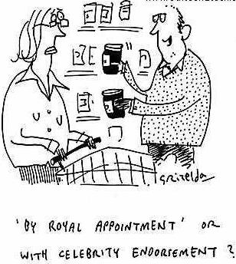
Pros and Cons of Brand Names
Brand names
Firms spend more on advertising and charge higher prices than generic (unbranded) substitutes
Critics of brand names
Creates product differentiation for products that are not actually differentiated
Consumers are irrational: willing to pay more for brand names and celebrity endorsements
Defenders of brand names
Consumers gain information about quality
Firms have incentive to maintain high quality to protect the brand

Slide 29


Advertising as a Costly Signal
“If they’re spending so much $$$ on advertising for this product, they must expect it to be profitable and be around a long time. Must be good.”

Slide 30
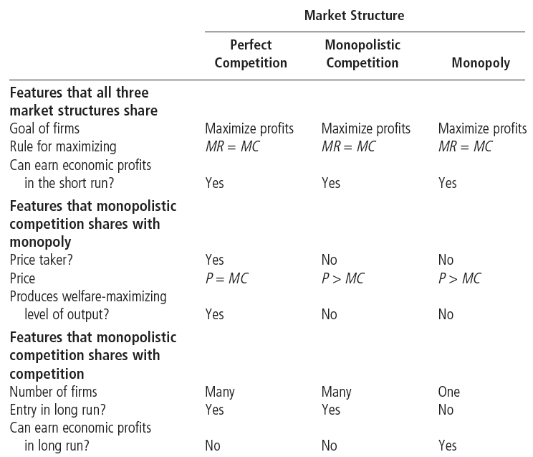
Between Perfect Competition and Monopoly

Slide 31
Welfare of Society: Sources of Inefficiency
In the short run
Markup of price over marginal cost
Deadweight loss of monopoly pricing
Some welfare improving trades are not made
Wasteful spending on advertising to product differentiate
In the long run
Too much entry
Firms produce less than quantity that minimizes ATC
Too many firms exist – duplication of fixed costs
ATC is higher than minimum ATC
Off-set by
Product-variety benefit for consumers

Slide 32
Summary
Monopolistic competition is a market structure in which there are many competing producers, each producing a differentiated product, and there is free entry and exit in the long run. Product differentiation takes three main forms: by style or type, by location, or by quality.
Short-run profits will attract entry of new firms in the long run. This reduces the quantity each existing producer sells at any given price and shifts its demand curve to the left. Short-run losses will induce exit by some firms in the long run. This shifts the demand curve of each remaining firm to the right.

Slide 33
Summary
In the long run, a monopolistically competitive industry is in zero-profit equilibrium: at its profit-maximizing quantity, the demand curve for each existing firm is tangent to its average total cost curve. There are zero profits in the industry and no entry or exit.
In long-run equilibrium, firms in a monopolistically competitive industry sell at a price greater than marginal cost. They also have excess capacity because they produce less than the minimum-cost output; as a result, they have higher costs than firms in a perfectly competitive industry.

Slide 34
Summary
A monopolistically competitive firm will always prefer to make an additional sale at the going price, so it will engage in advertising to increase demand for its product and enhance its market power. Advertising and brand names that provide useful information to consumers are economically valuable. But they are economically wasteful when their only purpose is to create market power. In reality, advertising and brand names are likely to be some of both: economically valuable and economically wasteful.

Slide 35
KEY TERMS
Monopolistic competition
Zero-profit equilibrium
Excess capacity
Brand name

